Slide 1
Polarization science with Carma probing small-scale magnetic fields in star-forming regions
Chat Hull
University of California, Berkeley
Radio Astronomy Laboratory
10 April 2013
Special Session: Polarization
ALMA 2013 Rocks!
Kona, Hawai’i
Notes:
Star formation regions

Slide 2
Outline
CARMA
1mm polarization system
Science results & future proposals
TADPOL survey: protostellar polarization
Circumstellar disk polarization & formation
Other projects: Serpens, SgrA*

Slide 3
Outline
CARMA
1mm polarization system
Science results & future proposals
TADPOL survey: protostellar polarization
Circumstellar disk polarization & formation
Other projects: Serpens, SgrA*

Slide 4
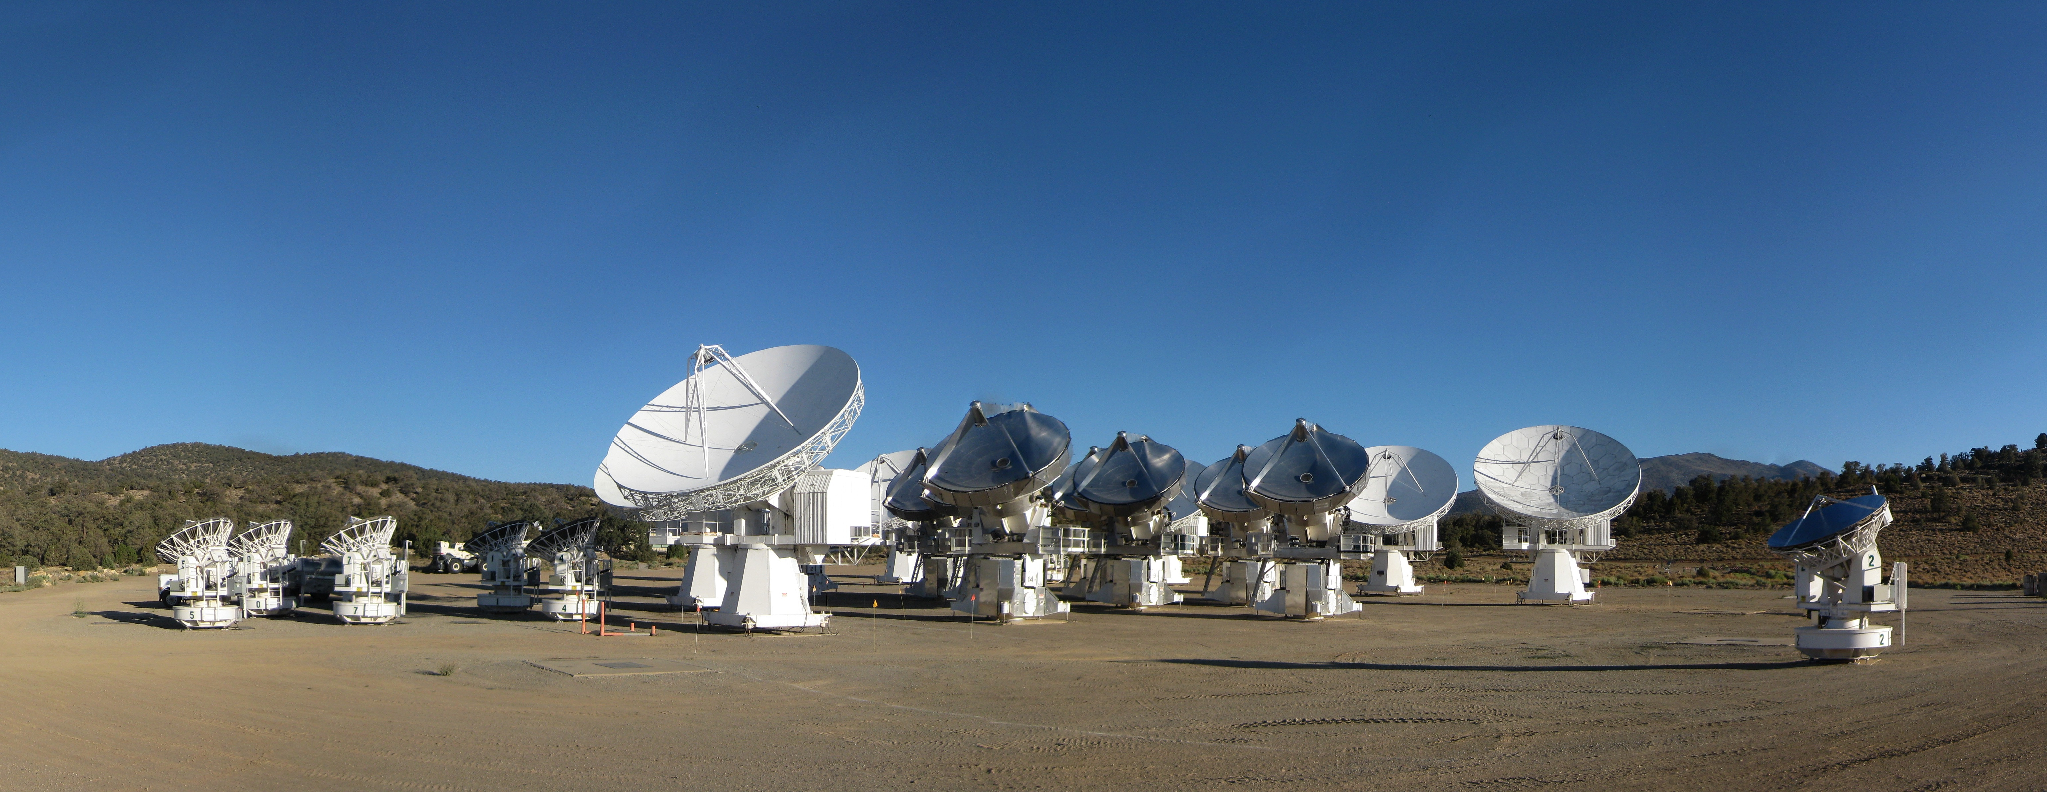
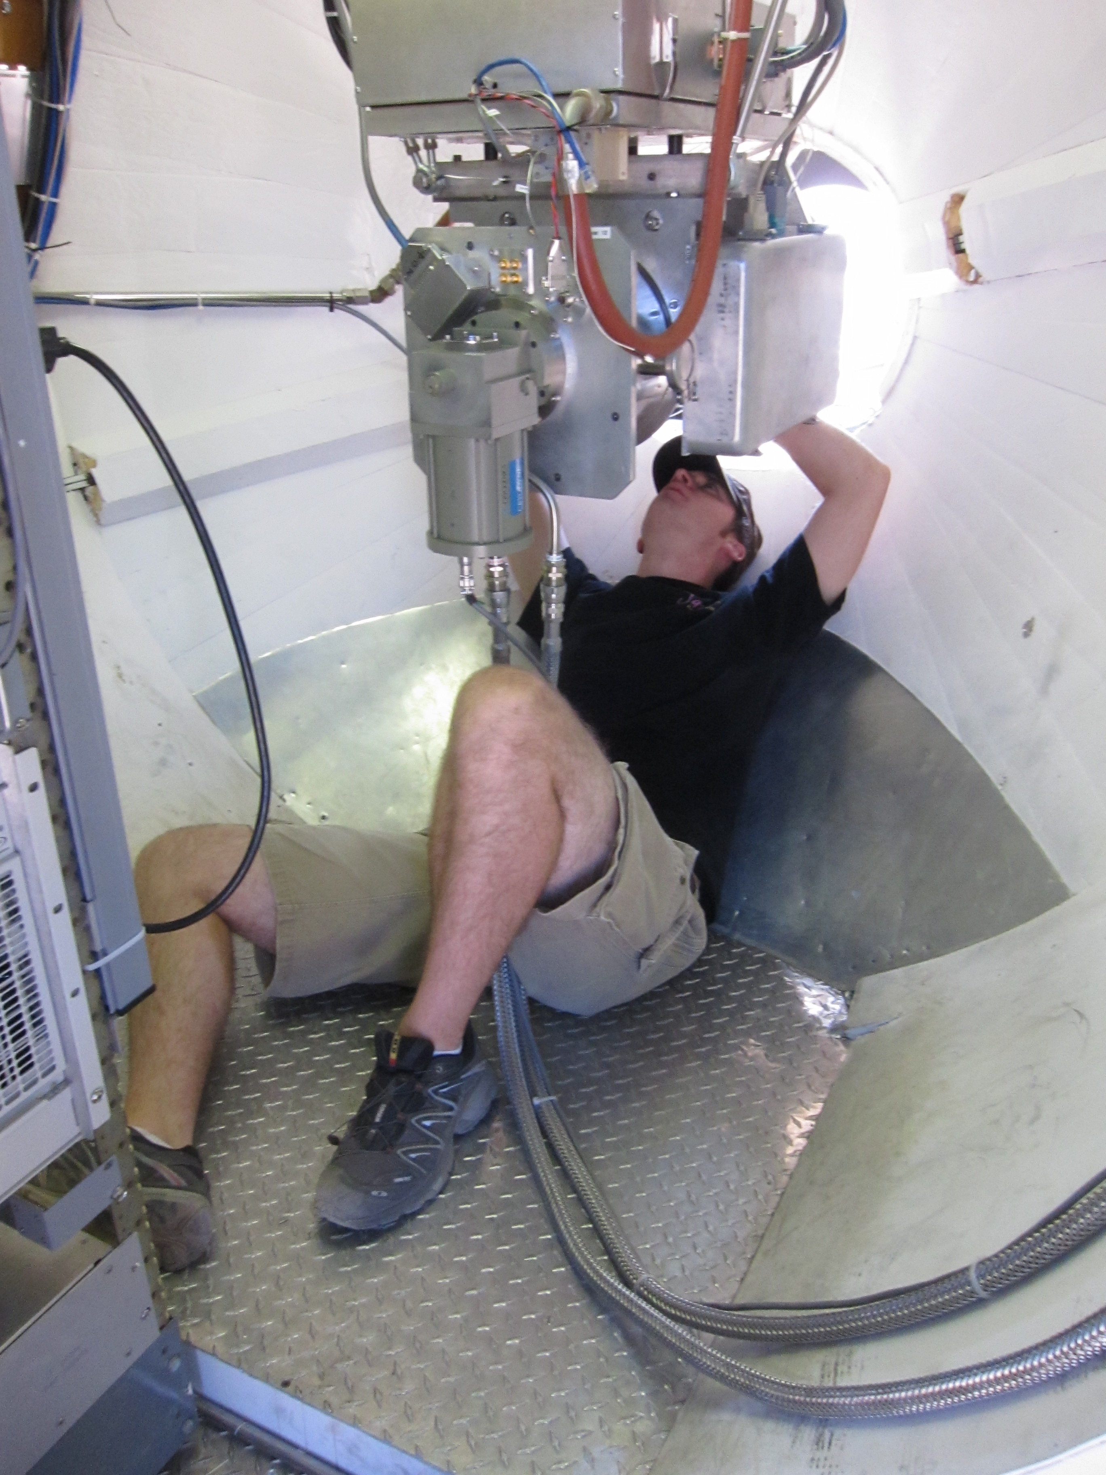
CARMA Combined Array for Research in Millimeter-wave Astronomy Consortium: Berkeley, Caltech, Illinois, Maryland, Chicago
6 ⨯10-m, 9 ⨯ 6-m, 8 ⨯ 3.5-m telescopes
Observations at 1 cm, 3 mm, and 1 mm (polarization!)
Located in Cedar Flat, CA (near Bishop)
Notes:
SMA: 8*6m antennas = 226 m^2
CARMA: 6*10m, 9*6m = 726 m^2 (more than factor of 3 more area)
-Factor of two more dishes
-Equivalent T_sys?

Slide 5
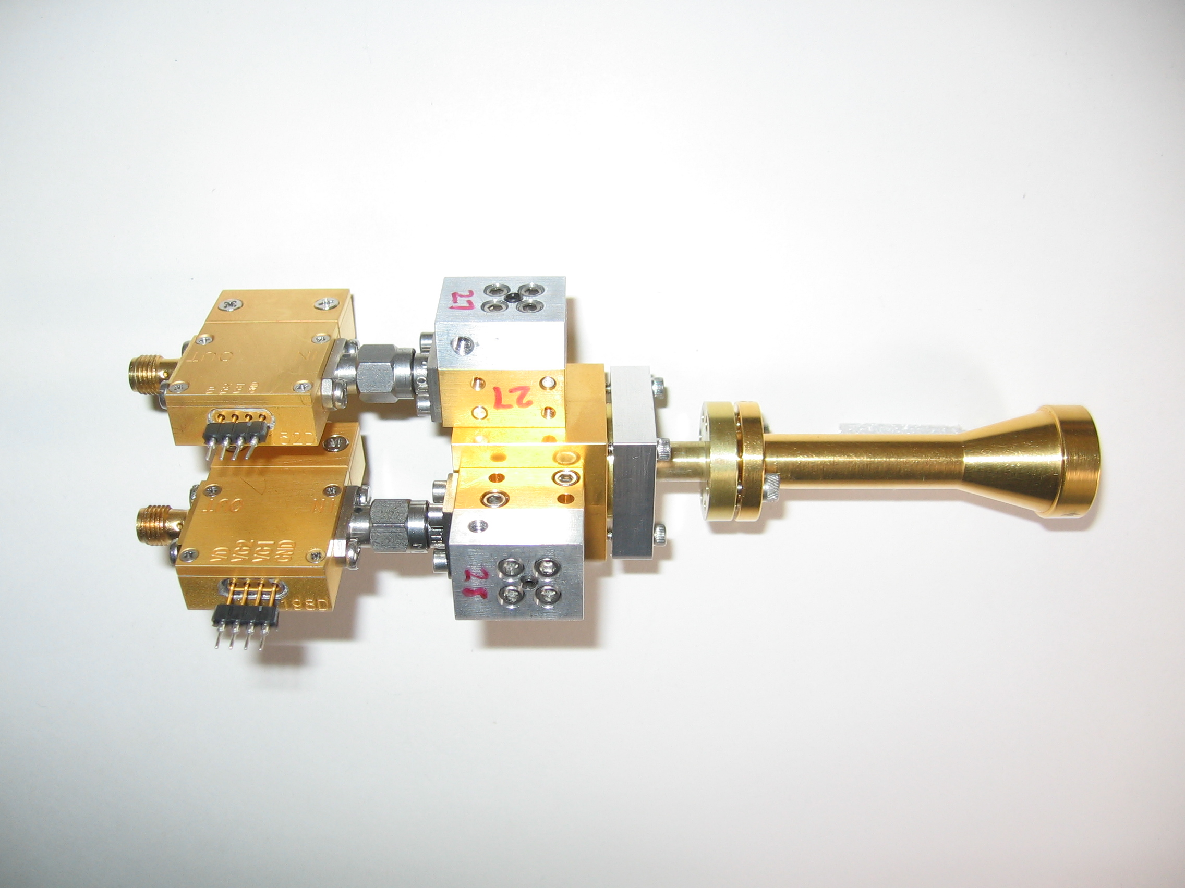
1 mm dual-polarization receivers
SIS mixers
Orthomode transducer
Waveguide circular polarizer
1 inch
WBA13
I.F. amplifiers (1-9 GHz)
Credit: Dick Plambeck
Notes:
-Sensitive to RCP & LCP
-Null experiment: in the absence of linear polarization, you get no RL correlation at any time.
-If you have linear feeds, you have XY correlation sometimes (when the intrinsic polarization is at 45º to your two feeds), and not other times (when it’s along one feed or the other). Thus, to tease out the polarization, you need stable gains

Slide 6
Wideband, 2-section polarizer
λ/2 retarder
at 15°
λ/4 retarder
at 74.5°
Plambeck & Engargiola, CARMA Memo #54
Notes:
-Chose waveguide design because it can be integrated into the receiver (in the cold part), and thus doesn’t create loss the way a room-temperature quarter-wave plate does.

Slide 7
R L → → →
Polarizer simulation
← Feed horn (sky)
OMT →
Sky
Receiver
Plambeck & Engargiola, CARMA Memo #54
RCP
X
LCP
Y
Credit: Greg Engargiola
Y
X
Notes:
These are effectively quarter-wave plates. However, we get dual-circular over the entire band -- "wideband waveguide circular polarizers,” thus enabling RM.

Slide 8
Outline
CARMA
1mm polarization system
Science results & future proposals
TADPOL survey: protostellar polarization
Circumstellar disk polarization & formation
Other projects: Serpens, SgrA*

Slide 9
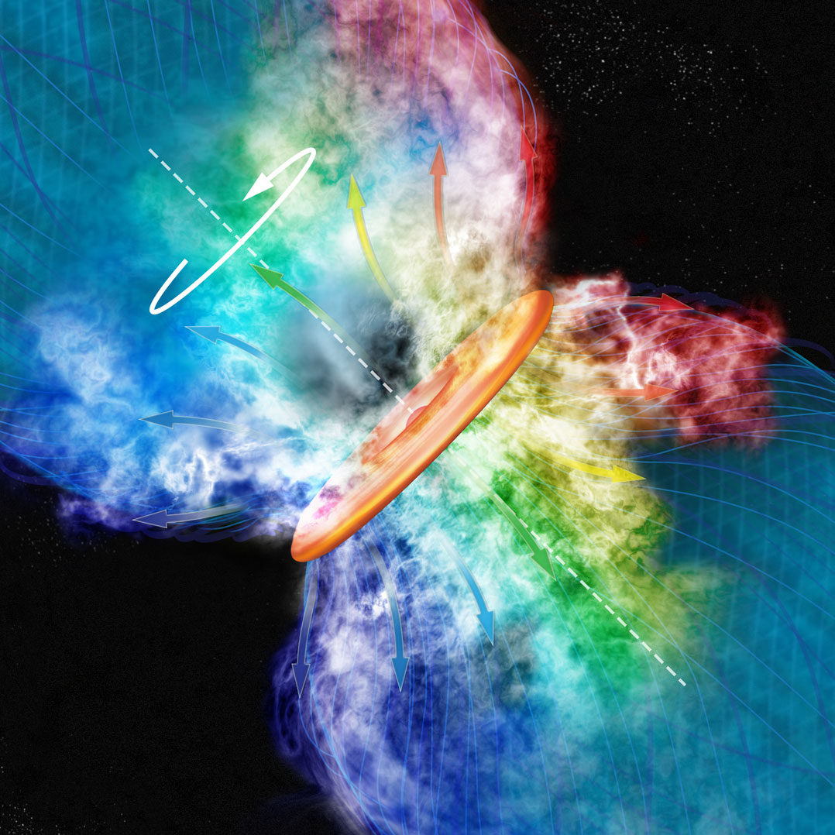
Credit: Bill Saxton, Harvard-Smithsonian Center for Astrophysics

Slide 10
Misalignment of B-fields and outflows
IRAS 4A
IRAS 16293
Rao+ 2009
Outflow
B-field
Girart+ 2006
Notes:
ROTATION: IRAS 16293 has rot/grav < 0.1; IRAS4A seems the same (barely any rotation); VLA 1623 questionable (probably slow)
-Holland: JCMT data
-Rao, Girart: SMA
-This is okay, according to Hennebelle & Ciardi ‘09 (easier to form disks with obliquity!)
-Ward-Thompson et al (2009) saw a 30 deg offset between short axes of cores and their polarization directions…another problem!

Slide 11
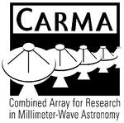












TADPOL collaboration
UC Berkeley
Chat Hull (PI), Dick Plambeck, Mel Wright, Carl Heiles, Geoff Bower
University of Maryland
Marc Pound, Alberto Bolatto, Katherine Jameson,
Lee Mundy
Caltech
Thushara Pillai, John Carpenter, James Lamb,
Nikolaus Volgenau
University of Illinois, Urbana-Champagne
Ian Stephens, Leslie Looney, Woojin Kwon,
Dick Crutcher, Nick Hakobian
Other
Dan Marrone (Arizona), Meredith Hughes (Wesleyan), John Vaillancourt & Göran Sandell (USRA-SOFIA), John Tobin (NRAO), Jason Fiege (Manitoba),
Erica Franzmann (Manitoba), Martin Houde (UWO, Caltech), Brenda Matthews (NRC-CNRC)

Slide 12
TADPOL survey
35 sources
Triples number of interferometric polarization maps
~300 observing hours
CARMA C, D, & E arrays
1 – 4" resolution
10⨉ higher resolution than CSO & JCMT
Probes intermediate region between ~0.1 pc (single-dish)
and ~100 AU (ALMA)

Slide 13
TADPOL results
L1157
See also: Stephens, Looney, Kwon, Hull et al. 2013, ApJL, submitted
Notes:
NEARBY SF regions:
-Perseus (NGC 1333, L1448, SVS13): 235 pc (masers in SVS13) → 03:30 LST
-Taurus (DG Tau, L1527): 140 pc → 04:30 LST
-Orion: 400 pc → 05:30 LST
-Serpens: 415 pc → 18:30 LST
-Ophiuchus: 140 pc → 17:00 LST
-Cepheus (L1157): 250 pc → 22:00 LST
-Isolated (B335, Bok globule): 250 pc

Slide 14
Credit: Bill Saxton, Harvard-Smithsonian Center for Astrophysics

Slide 15
TADPOL results
NGC 1333-IRAS 4B
NGC 1333-IRAS 4A
Notes:
NEARBY SF regions:
-Perseus (NGC 1333, L1448, SVS13): 235 pc (masers in SVS13) → 03:30 LST
-Taurus (DG Tau, L1527): 140 pc → 04:30 LST
-Orion: 400 pc → 05:30 LST
-Serpens: 415 pc → 18:30 LST
-Ophiuchus: 140 pc → 17:00 LST
-Cepheus (L1157): 250 pc → 22:00 LST
-Isolated (B335, Bok globule): 250 pc

Slide 16
TADPOL results
L1527
NGC 1333-IRAS 2A
Notes:
NEARBY SF regions:
-Perseus (NGC 1333, L1448, SVS13): 235 pc (masers in SVS13) → 03:30 LST
-Taurus (DG Tau, L1527): 140 pc → 04:30 LST
-Orion: 400 pc → 05:30 LST
-Serpens: 415 pc → 18:30 LST
-Ophiuchus: 140 pc → 17:00 LST
-Cepheus (L1157): 250 pc → 22:00 LST
-Isolated (B335, Bok globule): 250 pc

Slide 17
TADPOL results
Ser-emb 8
Notes:
NEARBY SF regions:
-Perseus (NGC 1333, L1448, SVS13): 235 pc (masers in SVS13) → 03:30 LST
-Taurus (DG Tau, L1527): 140 pc → 04:30 LST
-Orion: 400 pc → 05:30 LST
-Serpens: 415 pc → 18:30 LST
-Ophiuchus: 140 pc → 17:00 LST
-Cepheus (L1157): 250 pc → 22:00 LST
-Isolated (B335, Bok globule): 250 pc

Slide 18
Outflow vs. B-field: distribution
Simulation: outflows & B-fields aligned within a 20º cone (tightly aligned)
Simulation: outflows & B-fields are randomly oriented
Cumulative Distribution Function (CDF)
Simulation: outflows & B-fields aligned between 70–90º (preferentially misaligned)
KS-test results:
20º cone ruled out ( p-value ~ 10⁻⁹ )
Misaligned ( 0.79 ) and random ( 0.64 ) cannot be ruled out
Hull+ 2013, ApJ, accepted Preprint: arXiv:1212.0540
(Projected) angle between outflow & B-field (deg)

Slide 19
Upper limits on circumstellar disk polarization
CARMA + SMA results
Disks are not strongly polarized at ~100 AU scales:
Hughes, Hull, Wilner, & Plambeck 2013, AJ, 145, 115
Notes:
Tamura+99 – JCMT results
-Other sources: GM Aur, MWC 480

Slide 20
Implications for disk formation
Weak & misaligned B-fields in cores could aid disk formation
Addresses “magnetic braking catastrophe”
Points are from simulations in Joos+ 2012
We find that ~10–50% of Class 0/I stars should form Keplerian disks
cos( 𝛉 between B-field & disk axis )
Flux-to-mass ratio
Krumholz, Crutcher, & Hull 2013, ApJL, 767, L11

Slide 21
Other projects
Filamentary B-field structure in Serpens
Observing same field as ALMA (Mundy et al.)
Galactic center (SgrA*)
Rotation measure, simultaneous with SMA
G2 cloud

Slide 22
Summary
CARMA 1 mm polarization system is fully functional, and accepting proposals (next deadline is next month (May, ‘13))
Wide array of science
TADPOL results: B-fields are either preferentially misaligned (perp.) or randomly aligned with respect to outflows at the ~1000 AU scale
Thus, circumstellar disks are misaligned with fields in the cores from which they formed
TADPOL results: arXiv:1212.0540
TADPOL survey (CARMA key project): tadpol.astro.illinois.edu
Questions? Email: chat@astro.berkeley.edu
Notes:
Other TADPOL future possibilities:
Intrinsic modeling of B-fields in cores (Fiege)
Constraints on B-fields in protoplanetary disks (Hughes)
Turbulence power spectra (Houde)
Larger scale background-star maps (Mimir, Jameson/Pillai/Clemens)

Slide 23
Fin

